Slide 1
AppShed Quiz Show

Slide 2
AppShed is a piece of software.

Slide 3
How Can I View My App Online?
By Publishing It Then Clicking Web App

Slide 4
What is the name of icons on the bottom of the screen?
Tabs

Slide 5
How do I upload images?
Click profile name then files
All of the answers
Click profile name then images
Click image on standard screen items
Make a gallery tab then edit the image

Slide 6
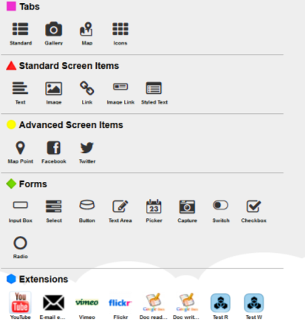
End
1
2
3
4
5
6
7
8
9
10
Memorise it, 10 secs from now!

Slide 7
AppShed Is A Downloadable Piece Of Software
It is an online piece
Of software

Slide 8
Match them up
Tabs
Blue Hexagon
Standard Screen Items
Yellow Circle
Advanced Screen Items
Purple Square
Forms
Red Triangle
Extensions
Green Diamond

Slide 9
How many types of tab can you have?
4
Standard, Map, Icons & Gallery

Slide 10


Match Up The Type Of Icon To Its Word
Image
Link
Standard Tab
Gallery Tab
Map Point

Slide 11
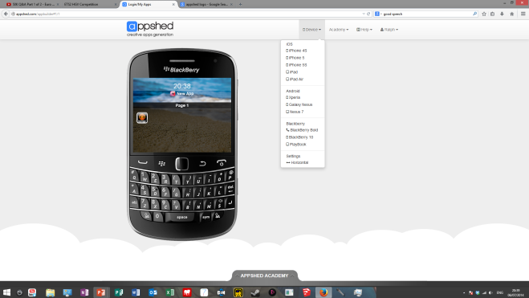
End
1
2
3
4
5
6
7
8
9
10
Memorise it, 10 secs from now!

Slide 12
How many devices can you simulate in AppShed
8
6
13
11
9

Slide 13
You Can Simulate Windows Phones

Slide 14
How Many Tabs Can You Have Maximum
7
2
9
5
3

Slide 15
What Software Does A Map Tab Link To?
Google Maps

